Slide 1
Spatial Frequency Extraction using Gradient-liked Operator (SFEGO) 空間頻率擷取使用類梯度運算子
研究生：林以鎬
指導教授：蕭子健
Notes:
Spatial Frequency Extraction using Gradient-liked Operator

Slide 2
Outline
Introduction
Material and Method
Experiment and Result
Discussion
Conclusion
Future Work
1.1 Background
1.2 Motivation
1.3 Literature study
1.4 Spatial Frequency
1.5 Local Binary Pattern
1.6 Gradient
1.7 Gradient Mask
1.8 Objective
3.1 Decomposition of square border
3.2 Decomposition of a different spatial frequency 2D signal
3.3 Decomposition of Lena
3.4 Decomposition of Squirrel
3.5 Decomposition of London Bridge
4.1 Circular Mask v.s. Square Mask
4.2 Direction issue on small radius
4.2.1 Improve high frequency extraction
4.3 Performance - SFEGO and MEEMD
4.3 Performance - GPU Computing
4.3.1 Performance - Down Sampling
4.4 MEEMD Emulation
2.1 Procedure
2.2 Choose circular mask size
2.3 Gradient-liked operator
- Pixel classifier
- Analyze direction
- Analyze magnitude
2.5 Calculation of Projection
Notes:
Background <- Tree … done
Literature Study -> Background … done
Literature Study <- other related paper
Introduction of gradient -> Introduction
GMEMD Procedure -> Procedure

Slide 3
1.1 Background
Dimension
Time Complexity
MEEMD
2009
nD
Mode Mixing
BEMD
2003
FABEMD
2008
PLS-EMD 2012
2D
EMD
1998
EEMD
2009
CEEMD
2010
1D
Time
Notes:
Delope trend of emd
Plsemd
Ebemd?

Slide 4
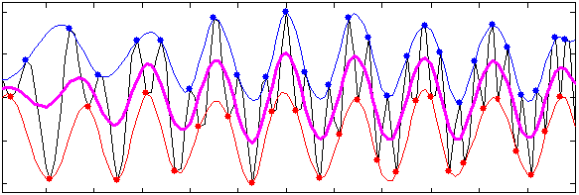
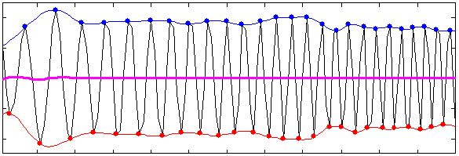
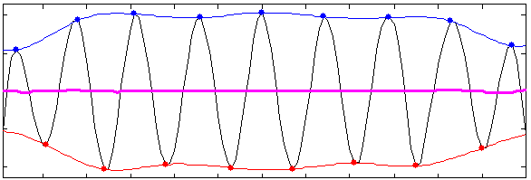
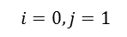
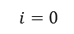
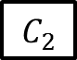
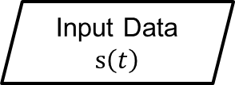
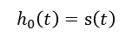
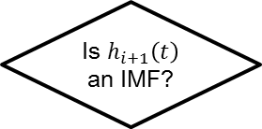
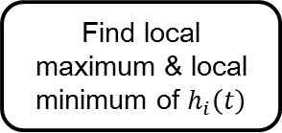
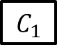
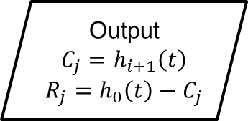
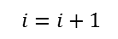
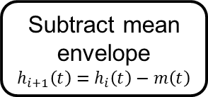
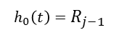
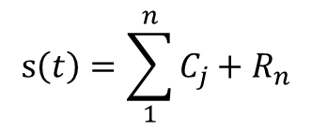
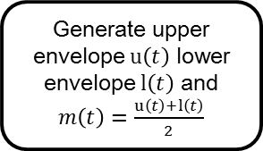
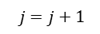
Empirical Mode Decomposition
EMD
Input Data $s\left(t\right)$
$$i=0,j=1$$
$$h_{0}\left(t\right)=s\left(t\right)$$
Find local maximum & local minimum of $h_{i}\left(t\right)$
Input Data
Generate upper envelope $u\left(t\right)$ lower envelope $l\left(t\right)$ and $m\left(t\right)=\frac{u\left(t\right)+l\left(t\right)}{2}$
$$C_{1}$$
Subtract mean envelope
$$h_{i+1}\left(t\right)=h_{i}\left(t\right)−m\left(t\right)$$
$$i=i+1$$
Is $h_{i+1}\left(t\right)$ an IMF?
$$C_{2}$$
Output
$$C_{j}=h_{i+1}\left(t\right)$$
$$R_{j}=h_{0}\left(t\right)−C_{j}$$
No
Yes
$$j=j+1$$
Generate next IMF?
$$h_{0}\left(t\right)=R_{j−1}$$
$$s\left(t\right)=\sum_{1}^{n}{C_{j}+R_{n}}$$
$$i=0$$
Yes
IMF: Intrinsic Mode Function
No
N. E. Huang, et al., "The empirical mode decomposition and the Hilbert spectrum for nonlinear and non-stationary time series analysis“, Proceedings of the Royal Society of London. Series A: Mathematical, Physical and Engineering Sciences, 454(1971):903-995, 1998
End

Slide 5
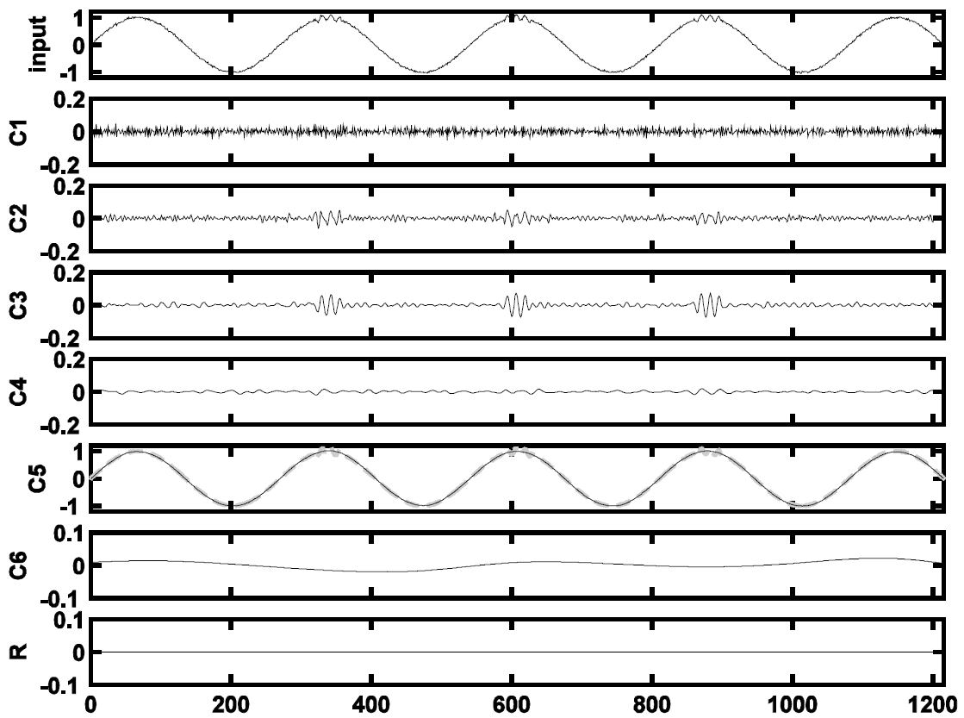
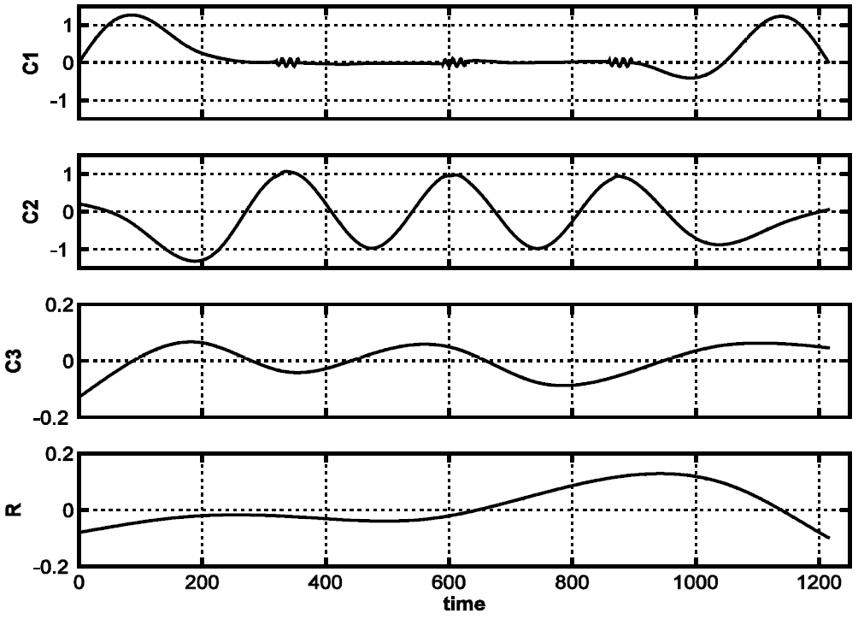
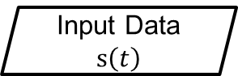
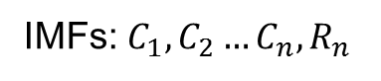
Ensemble Empirical Mode Decomposition
IMFs: $C_{1},C_{2}…C_{n},R_{n}$
Add white noise
EMD
IMFs
Average
Input Data $s\left(t\right)$
.
.
.
(Ensemble)
.
.
.
Final
IMFs
Add white noise
EMD
IMFs
EMD
EEMD
Z.-H. Wu and N. E. Huang, "Ensemble empirical mode decomposition: a noise-assisted data analysis method“, Advances in Adaptive Data Analysis, 1(1):1-41, 2009
Notes:
the modeled data was a mixture of intermittent highfrequency
oscillations riding on a continuous low-frequency sinusoidal signal.

Slide 6
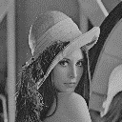
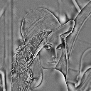
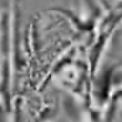
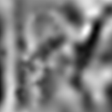

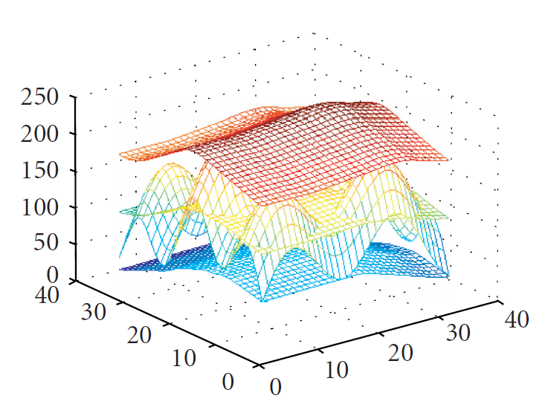
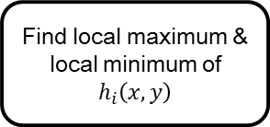
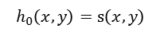
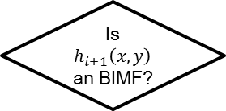
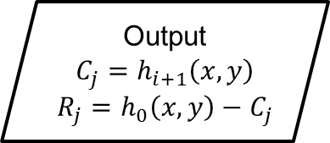
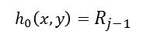
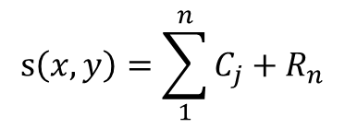
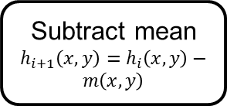
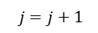
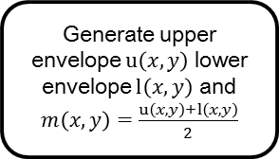
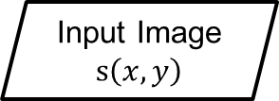
Bi-dimensional Empirical Mode Decomposition
BEMD
$$i=0,j=1$$
$$h_{0}\left(x,y\right)=s\left(x,y\right)$$
Find local maximum & local minimum of $h_{i}\left(x,y\right)$
Input Image $s\left(x,y\right)$
Generate upper envelope $u\left(x,y\right)$ lower envelope $l\left(x,y\right)$ and $m\left(x,y\right)=\frac{u\left(x,y\right)+l\left(x,y\right)}{2}$
Subtract mean $h_{i+1}\left(x,y\right)=h_{i}\left(x,y\right)−m\left(x,y\right)$
C1
C2
C3
C4
$$i=i+1$$
Is $h_{i+1}\left(x,y\right)$ an BIMF?
Output
$$C_{j}=h_{i+1}\left(x,y\right)$$
$$R_{j}=h_{0}\left(x,y\right)−C_{j}$$
No
$$j=j+1$$
Yes
$$h_{0}\left(x,y\right)=R_{j−1}$$
Generate next BIMF?
$$s\left(x,y\right)=\sum_{1}^{n}{C_{j}+R_{n}}$$
$$i=0$$
Yes
No
End
Jean Claude Nunes, et al, "Image analysis by bidimensional empirical mode decomposition", Image and Vision Computing, 21(12):1019-1026, 2003
Notes:
morphological operators to detect regional maxima
radial basis function for surface interpolation
XY coordinate

Slide 7
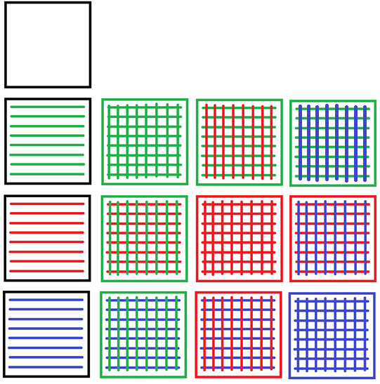

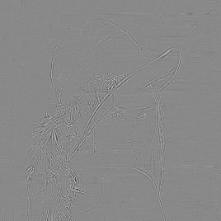
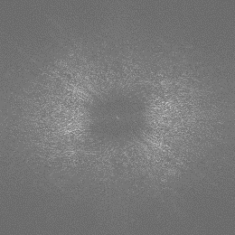
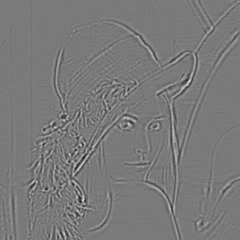
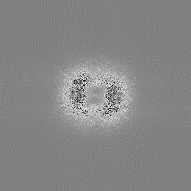
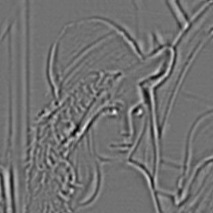
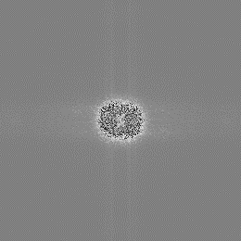
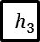
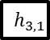
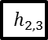
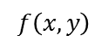
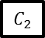
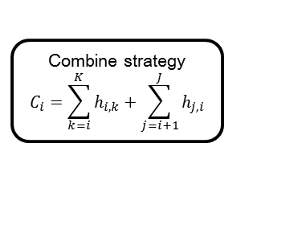












Multi-dimensional Ensemble Empirical Mode Decomposition
2D data
2DFT
Apply EEMD on each row
High
2nd
$$f\left(x,y\right)$$
$$\left|F\left(u,v\right)\right|$$
Result of 1st way EEMD
Apply EEMD on each column
$$h_{1}$$
$$h_{1,1}$$
$$h_{1,2}$$
$$h_{1,3}$$
$$C_{1}$$
Spatial Frequency
Result of 2nd way EEMD
$$h_{2}$$
$$h_{2,1}$$
$$h_{2,2}$$
$$h_{2,3}$$
$$C_{2}$$
Combine strategy
$$C_{i}=\sum_{k=i}^{K}{h_{i,k}}+\sum_{j=i+1}^{J}{h_{j,i}}$$
1st
$$h_{3}$$
$$h_{3,1}$$
$$h_{3,2}$$
$$h_{3,3}$$
$$R$$
BIMFs
Z.-H. Wu, N. E. Huang, and X.-Y. Chen. "The multi-dimensional ensemble empirical mode decomposition method“, Advances in Adaptive Data Analysis, 1(3):339-372, 2009
Low

Slide 8


1.2 Motivation
Computational cost
Data length: L (1D), L*K (2D)
Component number: $n_{m}$
Ensemble number: $n_{E}$
*Note:
Data length: 512 (1D), 512*512 (2D)
Component number: 4
Ensemble number: 50
CPU: Intel Pentium G2120
Method | # of EMD applied | Estimated Time | Execution time*
EMD | $$n_{m}$$ | 1 | 5.18$±$0.39 ms (1)
EEMD | $$n_{E}n_{m}$$ | 50 | 260.07$±$5.00 ms (50.2)
MEEMD | $$n_{E}\left(Ln_{m}+K\frac{(1+n_{m})n_{m}}{2}\right)$$ | 89600 | 476752.00$±$578.18 ms (92037.07)

Slide 9
1.3 Literature study
Year | Author | Algorithm | Execution time
2010 | Pulung Waskito | EMD | 7.1 times faster, L=215104, 8IMFs (CUDA)
2011 | L.-W. Chang | MEEMD | 62.14sec(47.1x) 666*444, 5BIMFs, En1000 (CUDA) 291.10sec(10.1x) 666*444, 5BIMFs, En1000 (OpenMP)
2012 | Maciej Wielgus | FABEMD | 25fps @ 640*480, 3BIMFs, FPGA, Order-Statistical Filters
2014 | Y.-H. Wang | MEEMD | 190.16sec @ 512*512, 6BIMFs, En100
2014 | J.-X. Feng | fast MEEMD | 30 times faster than MEEMD on ERSST, PCA+MEEMD
2014 | Kevin P.-Y. Huang | EMD (CUDA) | 37.9x and 33.7x speedup on voice and EEG datasets
2017 | B.-W. Shen | Parallel EEMD | 720x speedup using 200 eight-core processors (MPI+OpenMP)
Common performance issue
Can’t offload sifting processing.
Most wait for previous residual to generate next IMF.
Waskito, Pulung, et al. "Parallelizing Hilbert-Huang transform on a GPU."Networking and Computing (ICNC), 2010 First International Conference on. IEEE, 2010.
L.-W. Chang, et al. "Parallel implementation of multi-dimensional ensemble empirical mode decomposition" Acoustics, Speech and Signal Processing (ICASSP), 2011 IEEE International Conference on. IEEE, 2011
Maciej Wielgus, et al. "Fast and adaptive bidimensional empirical mode decomposition for the real-time video fusion." Information Fusion (FUSION), 2012 15th International Conference on. IEEE, 2012.
Y.-H. Wang, et al. "On the computational complexity of the empirical mode decomposition algorithm" Physica A: Statistical Mechanics and its Applications, 400:159-167, 2014
J.-X. Feng, et al. "Fast multidimensional ensemble empirical mode decomposition using a data compression technique.“, Journal of Climate 27.10: 3492-3504, 2014
Huang, Kevin PY, et al. "Flexible Parallelized Empirical Mode Decomposition in CUDA for Hilbert Huang Transform." High Performance Computing and Communications, 2014 IEEE 6th Intl Symp on Cyberspace Safety and Security, 2014 IEEE 11th Intl Conf on Embedded Software and Syst (HPCC, CSS, ICESS), 2014 IEEE Intl Conf on. IEEE, 2014.
Shen, Bo-Wen, et al. "Parallel Implementation of the Ensemble Empirical Mode Decomposition (PEEMD) and Its Application for Earth Science Data Analysis." Computing in Science & Engineering (2017).
Notes:
Without any phase distortion
Detail method of these and compare to spatial frequency
extended reconstructed sea surface temperature (ERSST)

Slide 10




1.4 Spatial Frequency on 2D DFT
Decomposition method:
Fourier Transform (2D DFT)
Hilbert-Huang Transform (BEMD, MEEMD)
Spatial Filter (Convolution)
Images are 2D functions f(x,y)
f(x,y)
Filter
High
Medium
Low
2DFT
Inverse
F(u,v)
mask
high-pass
band-pass
low-pass
Notes:
Mark original image

Slide 11




1.4 Spatial Frequency on MEEMD
Decomposition method:
Fourier Transform (2D DFT)
Hilbert-Huang Transform (BEMD, MEEMD)
Spatial Filter (Convolution)
MEEMD
Notes:
High light original picture

Slide 12



1.4 Spatial Frequency on Spatial Filter
Decomposition method:
Fourier Transform (2D DFT)
Hilbert-Huang Transform (BEMD, MEEMD)
Spatial Filter (Convolution)
Edge Detection

Slide 13


1.5 Local Binary Pattern
Local Binary Pattern (LBP) is a face description method which extract spatial relation from the circular region.
http://en.wikipedia.org/wiki/Local_binary_patterns
http://scikit-image.org/docs/0.13.x/auto_examples/features_detection/plot_local_binary_pattern.html
Ahonen T, Hadid A, Pietikainen M. Face description with local binary patterns: Application to face recognition[J]. IEEE transactions on pattern analysis and machine intelligence, 2006, 28(12): 2037-2041.

Slide 14






1.6 Gradient
The gradient can be used to measure how a scalar field change. It is widely used in Physics.
Continuous:
Discrete:
2D: $∇f=\frac{∂f}{∂x}\hat{x}+\frac{∂f}{∂y}\hat{y}$
Scalar Field $f$
3D: $∇f=\frac{∂f}{∂x}\hat{x}+\frac{∂f}{∂y}\hat{y}+\frac{∂f}{∂z}\hat{z}$
$$∇f\left(x,y\right)=$$
$$(f\left(x\text{+}1,y\right)−f\left(x,y\right))\hat{x}+$$
$$(f\left(x,y\text{+}1\right)−f\left(x,y\right))\hat{y}$$
 | (x,y+1)
 | (x,y) | (x+1,y)
Vector Field $∇f$
Notes:
+ original gradient mask

Slide 15


1.7 Gradient mask
Edge enhancement
Laser printing
Cloth folds detection
1 | 1 | 0
1 | 1 | 0
1 | 1 | 0
0 (don’t care) | 1 (and) | -1 (inverter)
0 (don’t care) | 1 (and) | -1 (inverter)
0 (don’t care) | 1 (and) | -1 (inverter)
*
bitmap pattern
gradient mask
(east segment)
Result: $1∙0+1∙1+0∙\left(\text{−}1\right)+1∙0+1∙1+0∙\left(\text{−}1\right)+1∙0+1∙1+0∙\left(\text{−}1\right)$
$$=0+1+1+0+1+1+0+1+1=6$$
Lung, James CY. "Edge enhancement method and apparatus for dot matrix devices“, U.S. Patent No. 5,029,108. 2 Jul. 1991.
filter
light stripped image
angle map
gradient mask
$$M_{k}(i,j)$$
$\left\|δ\left(i,j\right)\right\|$ is the magnitude of the gradient of the angle map at $\left(i,j\right)$
$τ$ is a value of user-defined threshold
Bhat, Kiran S., et al. "Estimating cloth simulation parameters from video“, Proceedings of the 2003 ACM SIGGRAPH/Eurographics Symposium on Computer Animation (San Diego, CA, USA)

Slide 16
1.8 Objective
Apply the gradient operator to a circular mask.
Expect to reconstruct corresponding spatial frequency with specified mask size.
Higher spatial frequency related to small scale mask
Lower spatial frequency related to large scale mask
Compare the reconstructed result with BIMF of MEEMD.
Mask
Gradient-liked
Operator
(GO)
Gradient
operator
Notes:
Apply, Purpose, Verify!!!

Slide 17












2.1 Procedure
SFEGO
Image
$$f\left(x,y\right)$$
Circular
mask size
$$2R\text{+}1$$
Gradient-liked
Operator
Gradient result
$$∇f\left(x,y\right)$$
Projection
Spatial frame ${SF}_{R}\left(x,y\right)$
R=1
R=2
R=3
.
.
.
This loop can be fully parallel.
Magnitude $A$
$$f\left(x,y\right)$$
$$s_{3}\left(x,y\right)$$
Direction $θ$
$$∇f\left(x,y\right)=Ae^{iθ}$$
Notes:
Color
R=1,2,3

Slide 18




2.2 Choose circular mask size
SFEGO
Image
$$f\left(x,y\right)$$
Circular
mask size
$$2R\text{+}1$$
Gradient-liked
Operator
Gradient result
$$∇f\left(x,y\right)$$
Projection
Spatial frame ${SF}_{R}\left(x,y\right)$
R | Square | Circular | Reduced | Percentage
1 | 9 | 9 | 0 | 0.000
2 | 25 | 21 | 4 | 0.160
3 | 49 | 45 | 4 | 0.082
4 | 81 | 69 | 12 | 0.148
5 | 121 | 101 | 20 | 0.165
6 | 169 | 137 | 32 | 0.189
7 | 225 | 185 | 40 | 0.178
8 | 289 | 241 | 48 | 0.166
9 | 361 | 293 | 68 | 0.188
10 | 441 | 357 | 84 | 0.190
11 | 529 | 429 | 100 | 0.189
12 | 625 | 497 | 128 | 0.205
13 | 729 | 593 | 136 | 0.187
14 | 841 | 673 | 168 | 0.200
15 | 961 | 777 | 184 | 0.191
16 | 1089 | 877 | 212 | 0.195
17 | 1225 | 981 | 244 | 0.199
18 | 1369 | 1093 | 276 | 0.202
19 | 1521 | 1201 | 320 | 0.210
20 | 1681 | 1345 | 336 | 0.200
21 | 1849 | 1481 | 368 | 0.199
22 | 2025 | 1617 | 408 | 0.201
23 | 2209 | 1757 | 452 | 0.205
24 | 2401 | 1901 | 500 | 0.208
25 | 2601 | 2077 | 524 | 0.201
26 | 2809 | 2233 | 576 | 0.205
27 | 3025 | 2401 | 624 | 0.206
28 | 3249 | 2585 | 664 | 0.204
29 | 3481 | 2761 | 720 | 0.207
30 | 3721 | 2949 | 772 | 0.207
Comparing to square mask, circular mask reduce the computational complexity up to 21%
 |  | C
 | C
R=2
R=1
Notes:
Graph for r-p
+0

Slide 19









2.3 Gradient-liked operator - Pixel classifier
SFEGO
 | 0 | 0 | 0 (x+i.y+j)
0 | 0 | 0 | 0 | 0
0 | 0 | C (x,y) | 1 | 0
1 | 0 | 0 | 1 | 1
 | 1 (x-i.y-j) | 1 | 1
Image
$$f\left(x,y\right)$$
Circular
mask size
$$2R\text{+}1$$
Gradient-liked
Operator
Gradient result
$$∇f\left(x,y\right)$$
Projection
Spatial frame ${SF}_{R}\left(x,y\right)$
Pixel
classifier
Analyze
direction$θ(x,y)$
Analyze
magnitude
$$a(x,y)$$
for each $f\left(x,y\right)$
.
.
.
This loop can be fully parallel.
Classify the pixel value
Class | Condition
-1 | $\left(x\text{+}i,y\text{+}j\right)$ out of image size
1 | $$f\left(x\text{+}i,y\text{+}j\right)≥f\left(x,y\right) AND f\left(x\text{+}i,y\text{+}j\right)≥f\left(x\text{−}i,y\text{−}j\right)$$
0 | $$otherwise$$
$Class \text{−}1, if \left(x\text{+}i,y\text{+}j\right)$ out of image size
$$Class 1, if \{ f\left(x\text{+}i,y\text{+}j\right)≥f\left(x,y\right) AND f\left(x\text{+}i,y\text{+}j\right)≥f\left(x\text{−}i,y\text{−}j\right) \}$$
$$Class 0, otherwise$$

Slide 20




2.3 Gradient-liked operator – Analyze direction
order | i | j | f | degree | radius | class
0 | 0 | 0 | 75 | - | - | -
1 | 1 | 0 | 248 | 0.0 | 1.00 | 1
2 | 2 | 0 | 69 | 0.0 | 2.00 | 0
3 | 2 | 1 | 54 | 26.6 | 2.24 | 0
4 | 1 | 1 | 70 | 45.0 | 1.41 | 0
5 | 1 | 2 | 239 | 63.4 | 2.24 | 0
6 | 0 | 1 | 73 | 90.0 | 1.00 | 0
7 | 0 | 2 | 35 | 90.0 | 2.00 | 0
8 | -1 | 2 | 75 | 116.6 | 2.24 | 0
9 | -1 | 1 | 18 | 135.0 | 1.41 | 0
10 | -2 | 1 | 20 | 153.4 | 2.24 | 0
11 | -1 | 0 | 65 | 180.0 | 1.00 | 0
12 | -2 | 0 | 20 | 180.0 | 2.00 | 0
13 | -2 | -1 | 128 | 206.6 | 2.24 | 1
14 | -1 | -1 | 136 | 225.0 | 1.41 | 0
15 | -1 | -2 | 78 | 243.4 | 2.24 | 1
16 | 0 | -1 | 60 | 270.0 | 1.00 | 0
17 | 0 | -2 | 101 | 270.0 | 2.00 | 1
18 | 1 | -2 | 122 | 296.6 | 2.24 | 1
19 | 1 | -1 | 185 | 315.0 | 1.41 | 1
20 | 2 | -1 | 189 | 333.4 | 2.24 | 1
1 | 1 | 0 | 248 | 0.0 | 1.00 | 1
2 | 2 | 0 | 69 | 0.0 | 2.00 | 0
3 | 2 | 1 | 54 | 26.6 | 2.24 | 0
4 | 1 | 1 | 70 | 45.0 | 1.41 | 0
5 | 1 | 2 | 239 | 63.4 | 2.24 | 0
6 | 0 | 1 | 73 | 90.0 | 1.00 | 0
7 | 0 | 2 | 35 | 90.0 | 2.00 | 0
8 | -1 | 2 | 75 | 116.6 | 2.24 | 0
9 | -1 | 1 | 18 | 135.0 | 1.41 | 0
Pixel
classifier
Analyze
direction
$$θ(x,y)$$
Analyze
magnitude
$$a(x,y)$$
Sliding Window
for each $f\left(x,y\right)$
weight
1
0
0
1
1
2
2
3
4
5
6
7
7
6
6
5
5
4
3
2
Direction $Θ=\left\{θ(x,y)\right\}$
Create a table by the ordering of degree and radius.
Move sliding window to find the largest weight. (highest number of class 1)
N/2
Opposite Window
 | 0 | 0 | 0 (x+i.y+j)
0 | 0 | 0 | 0 | 0
0 | 0 | C (x,y) | 1 | 0
1 | 0 | 0 | 1 | 1
 | 1 | 1 | 1
 | 8 | 7 | 5
10 | 9 | 6 | 4 | 3
12 | 11 | 0 (x,y) | 1 | 2
13 | 14 | 16 | 19 | 20
 | 15 | 17 | 18
N
sliding window size=N/2

Slide 21












2.3 Gradient-liked operator – Analyze direction
SFEGO
degree | weight
0.0 | 5
0.0 | 4
26.6 | 3
45.0 | 2
63.4 | 1
90.0 | 0
90.0 | 0
116.6 | 1
135.0 | 1
153.4 | 2
180.0 | 2
180.0 | 3
206.6 | 4
225.0 | 5
243.4 | 6
270.0 | 7
270.0 | 7
296.6 | 6
315.0 | 6
333.4 | 5
Circular
mask size
$$2R\text{+}1$$
Gradient-liked
Operator
Gradient result
$$∇f\left(x,y\right)$$
Projection
3
11
Pixel
classifier
Analyze
Direction
$$θ(x,y)$$
Analyze
magnitude
$$a(x,y)$$
for each $f\left(x,y\right)$
5
13
Direction $Θ=\left\{θ(x,y)\right\}$
$θ\left(x,y\right)=degree of largest weight$
7
17
 | 0 | 0 | 0
0 | 0 | 0 | 0 | 0
0 | 0 | C (x,y) | 1 | 0
1 | 0 | 0 | 1 | 1
 | 1 | 1 | 1
 | 0 | 0 | 0
0 | 0 | 0 | 0 | 0
0 | 0 | C (x,y) | 1 | 0
1 | 0 | 0 | 1 | 1
 | 1 | 1 | 1
 | 0 | 0 | 0
0 | 0 | 0 | 0 | 0
0 | 0 | C (x,y) | 1 | 0
1 | 0 | 0 | 1 | 1
 | 1 | 1 | 1
 | 0 | 0 | 0
0 | 0 | 0 | 0 | 0
0 | 0 | C (x,y) | 1 | 0
1 | 0 | 0 | 1 | 1
 | 1 | 1 | 1
 | 0 | 0 | 0
0 | 0 | 0 | 0 | 0
0 | 0 | C (x,y) | 1 | 0
1 | 0 | 0 | 1 | 1
 | 1 | 1 | 1
 | 0 | 0 | 0
0 | 0 | 0 | 0 | 0
0 | 0 | C (x,y) | 1 | 0
1 | 0 | 0 | 1 | 1
 | 1 | 1 | 1
1, 63.4 °
0, 90 °
0, 90 °
1, 116.6 °
1, 135 °
7, 270°

Slide 22














2.3 Gradient-liked operator – Analyze magnitude
SFEGO
Image
$$f\left(x,y\right)$$
Circular
mask size
$$2R\text{+}1$$
Gradient-liked
Operator
Gradient result
$$∇f\left(x,y\right)$$
Projection
Spatial frame ${SF}_{R}\left(x,y\right)$
3
11
Pixel
classifier
Analyze
direction
$$θ(x,y)$$
Analyze
magnitude
$$a(x,y)$$
for each $f\left(x,y\right)$
5
13
Magnitude $A=\left\{a\left(x,y\right)\right\}$
Largest weight sliding window: Largest Window
Opposite sliding window: Opposite Window
Ignore the pixel out of image size
The magnitude of gradient is
7
17
 | 1 | 0 | 1
0 | 0 | 0 | 0 | 0
0 | 0 | C (x,y) | 1 | 0
1 | 1 | 0 | 1 | 1
 | 1 | 1 | 1
$$a\left(x,y\right)=\sum_{Largest}{\frac{f\left(x\text{+}i,y\text{+}j\right)}{N_{L}}−\sum_{Opposite}{\frac{f\left(x\text{+}i,y\text{+}j\right)}{N_{O}}}}$$

Slide 23













2.4 Calculation of projection
SFEGO
Image
$$f\left(x,y\right)$$
Circular
mask size
$$2R\text{+}1$$
Gradient-liked
Operator
Gradient result
$$∇f\left(x,y\right)$$
Projection
Spatial frame ${SF}_{R}\left(x,y\right)$
3
11
Spatial frame is defined as
$${SF}_{R}\left(x,y\right)=\sum_{circular mask}{\frac{a\left(x\text{+}i,y\text{+}j\right)∙cos(θ\left(x,y\right)−φ\left(x\text{+}i,y\text{+}j\right))}{Circular Mask Size}}$$
5
13
7
17
 |  |  | (x+i, y+j)
 |  | C (x,y)
$$φ$$
$$A=\left\{a\left(x,y\right)\right\}$$
$$Θ=\left\{θ(x,y)\right\}$$
Notes:
Unit vector

Slide 24

2.5 Result comparison
Compare MEEMD and SFEGO using correlation coefficient
Correlation Coefficient:
$$r_{xy}=\frac{\sum_{i=1}^{n}{\left(X_{i}−\overline{X}\right)\left(Y_{i}−\overline{Y}\right)}}{\sqrt{\sum_{i=1}^{n}{{\left(X_{i}−\overline{X}\right)}^{2}}}\sqrt{\sum_{i=1}^{n}{{\left(Y_{i}−\overline{Y}\right)}^{2}}}}$$

Slide 25












3.1 Decomposition of a square border
Correlation
=
+
Radius
$$\sin\left(0.3x\right)+sin⁡(0.3y)$$
(R, Correlation)
1, 0.534762
7, 0.982886
128*128 pixels
SFEGO
(R, Correlation)
1, 0.65406
6, 0.94775
SFEGO
Original
MEEMD
MEEMD
BIMF1
BIMF2
BIMF3
BIMF4
BIMF1, 0.516775
BIMF2, 0.948451
Notes:
0.75!!!!!! -> 1
Cut ch3 and ch2
Mark Radius

Slide 26





3.1 Decomposition of a square border
FFT (left) and histogram of FFT (right)
(R, Correlation)
1, 0.564408
6, 0.975439
SFEGO
Amplitude
Filter
FFT
Frequency

Slide 27




















3.2 Decomposition of a different spatial frequency 2D signal
Correlation
+
+
F
$$F1=\sin\left(0.2r\right) at (32,32) (32,96) (96,96)$$
Radius
$$\left.F2=sin\left(0.5r\right) at (64,64\right)$$
(R, Correlation)
11, 0.963214
$$F=F1+F2$$
2, 0.917121
=
+
SFEGO
F1
F2
128*128 pixels
(R, Correlation)
3, 0.89478
9, 0.826249
16, 0.678332
SFEGO
Original
MEEMD
MEEMD
BIMF1
BIMF2
BIMF3
BIMF4
BIMF3, 0.796935
BIMF2, 0.934953
Notes:
IMF2 v.s. F2=0.934953
IMF3 v.s. F1=0.796935
IMF4 v.s. F1=0.605737

Slide 28







3.2 Decomposition of a different spatial frequency 2D signal
(R, Correlation)
3, 0.882264
9, 0.967939
16, 0.910425
SFEGO
Filter
Amplitude
FFT
Frequency

Slide 29







3.3 Decomposition of Lena
Correlation
512*512 pixels
(R, Correlation)
1, 0.734043
Radius
2, 0.873041
5, 0.883701
12 0.879943
26, 0.892705
SFEGO
MEEMD
BIMF1
BIMF2
BIMF3
BIMF4
BIMF5
Notes:
Ensemble=500

Slide 30






3.3 Decomposition of Lena
Amplitude
Frequency
R1
R2
R5
R12
R26
SFEGO
FFT

Slide 31





3.3 Decomposition of Lena
(R, Correlation)
1, 0.566475
2, 0.726945
5, 0.714091
12 0.800236
26, 0.763036
SFEGO
Filter
FFT

Slide 32












3.4 Decomposition of Squirrel
Correlation
Radius
(R, Correlation)
1, 0.681925
2, 0.867493
6, 0.894679
13, 0.902212
31, 0.861749
SFEGO
MEEMD

Slide 33






3.4 Decomposition of Squirrel
Amplitude
Frequency
R1
R2
R6
R13
R31
SFEGO
FFT

Slide 34





3.4 Decomposition of Squirrel
(R, Correlation)
1, 0.450509
2, 0.623741
6, 0.698305
13, 0.747155
31, 0.728210
SFEGO
Filter
FFT

Slide 35












3.5 Decomposition of London Bridge
Correlation
Radius
(R, Correlation)
1, 0.682149
2, 0.860141
5, 0.883527
12, 0.885539
28, 0.833850
SFEGO
MEEMD

Slide 36






3.5 Decomposition of London Bridge
Amplitude
Frequency
R1
R2
R5
R12
R28
SFEGO
FFT

Slide 37





3.5 Decomposition of London Bridge
(R, Correlation)
1, 0.649928
2, 0.738512
5, 0.744989
12, 0.824506
28, 0.692563
SFEGO
Filter
FFT

Slide 38





4.1 Circular Mask v.s. Square Mask
(R, Correlation)
1, 0.67133
5, 0.88080
2, 0.87312
12, 0.87776
26, 0.89156
SFEGO
Circular Mask
MEEMD
SFEGO
Square Mask
1, 0.67133
2, 0.87312
5, 0.88322
11, 0.87478
23, 0.88697

Slide 39





4.1.2 Traditional Gradient Operator
Use traditional gradient to do the same work and integral into spatial frame.
Traditional gradient only contain high frequency information which cause the bad result on large radius.
R1
R2
R5
R12
R26

Slide 40





4.2 Direction issue on small radius
SFEGO
128x128
R1
R2
R3
R4
R5
The direction of gradient is limited to the number of pixels in circle.
Small Radius
 | M

Slide 41









4.2.1 Improve high frequency extraction (Up Sampling)
Image
$$f\left(x,y\right)$$
Up Sampling
× N
SFEGO
Down
Sampling
÷ N
Spatial frame $s_{R}\left(x,y\right)$
BIMF2
R3 x1 ER3
0.892088
R6 x2 ER3
0.907032
R12 x4 ER3
0.913494
BIMF1
R1 x1 ER1
0.705154
R2 x2 ER1
0.743772
R4 x4 ER1
0.800833
R:Radius x:UpSampleRatio ER:Effective Radius

Slide 42
4.3 Performance SFEGO v.s. MEEMD
N: Number of pixels in circular mask.
Testing Parameters
Picture: Lena
Size: 512x512 Pixels
MEEMD Ensemble: 50
SFEGO |  |  | MEEMD |  | Speedup
R | Pixels | Time(s) | IMF | Time(s)
1 | 8 | 0.237 | 1 | 78.02 | 329.1983
2 | 20 | 0.613 | 2 | 175.337 | 286.031
3 | 44 | 1.098
4 | 68 | 1.632
5 | 100 | 2.504
6 | 136 | 3.259 | 3 | 299.142 | 91.78951
7 | 184 | 4.371
8 | 240 | 5.627
9 | 292 | 6.798
10 | 356 | 8.438
11 | 428 | 9.627
12 | 496 | 11.441 | 4 | 446.169 | 38.99738
13 | 592 | 13.441
14 | 672 | 15.48
15 | 776 | 16.79
16 | 876 | 18.786
17 | 980 | 20.828
18 | 1092 | 23.536
19 | 1200 | 25.801
20 | 1344 | 28.39
21 | 1480 | 31.516
22 | 1616 | 34.624
23 | 1756 | 39.043
24 | 1900 | 40.34
25 | 2076 | 43.568
26 | 2232 | 47.189 | 5 | 616.073 | 13.05544
27 | 2400 | 50.709
28 | 2584 | 53.938
29 | 2760 | 58.066
30 | 2948 | 61.916
CPU: Intel Core i7-3770 @3.4Ghz
Notes:
R:Radius N:Number of pixels in circular mask

Slide 43
4.3 Performance GPU Computing
CPU
SFEGO |  | C++ | OpenCL | Speedup
R | Pixels | Times (sec) | Times (sec)
1 | 8 | 0.274 | 0.015 | 18.33333
2 | 20 | 0.712 | 0.015 | 46.93333
3 | 44 | 1.288 | 0.016 | 78.9375
4 | 68 | 1.825 | 0.016 | 114.3125
5 | 100 | 2.848 | 0.019 | 149.1053
6 | 136 | 3.775 | 0.02 | 187.35
7 | 184 | 4.941 | 0.021 | 234.3333
8 | 240 | 6.34 | 0.025 | 252.36
9 | 292 | 7.748 | 0.025 | 308.28
10 | 356 | 9.396 | 0.028 | 335.8214
11 | 428 | 10.995 | 0.033 | 332.4545
12 | 496 | 12.946 | 0.034 | 379.5882
13 | 592 | 15.24 | 0.045 | 337.5333
14 | 672 | 17.392 | 0.043 | 404.3488
15 | 776 | 19.812 | 0.045 | 439.3556
16 | 876 | 22.445999 | 0.054 | 409.7963
17 | 980 | 25.004 | 0.052 | 480.8654
18 | 1092 | 27.875999 | 0.064 | 435.4531
19 | 1200 | 30.889 | 0.074 | 417.0135
20 | 1344 | 34.154999 | 0.083 | 408.5301
21 | 1480 | 37.726002 | 0.091 | 411.4835
22 | 1616 | 41.153999 | 0.098 | 415.2041
23 | 1756 | 44.216 | 0.096 | 459.0521
24 | 1900 | 47.949001 | 0.09 | 531.5667
25 | 2076 | 51.848 | 0.111 | 465.937
26 | 2232 | 56.125 | 0.123 | 455.2846
27 | 2400 | 60.174999 | 0.133 | 451.0902
28 | 2584 | 64.321999 | 0.138 | 464.3551
29 | 2760 | 68.949997 | 0.146 | 470.8151
30 | 2948 | 73.912003 | 0.15 | 488.7933
Input Image
Allocate Memory
Execute
Read
Memory
Output
GPU
Global Memory
OpenCL Kernel Function
Environment:
CPU: Intel Pentium G2120 (2012, 22nm)
TDP: 55W
GPU: AMD R9 280X (2013, 28nm)
2048 Stream Processing Units
TDP: 250W

Slide 44




4.3.1 Performance Down Sampling
Down Sampling Ratio | SFEGO Radius | Effective Radius | GPU with Original Radius | GPU with Down Sampling | Speedup | Correlation Coefficient
1 | 1 | 1 | 0.015 | 0.015 | 1 | 1
1 | 2 | 2 | 0.015 | 0.015 | 1 | 1
1 | 3 | 3 | 0.016 | 0.016 | 1 | 1
1 | 4 | 4 | 0.016 | 0.016 | 1 | 1
1 | 5 | 5 | 0.019 | 0.019 | 1 | 1
1 | 6 | 6 | 0.02 | 0.02 | 1 | 1
1 | 7 | 7 | 0.021 | 0.021 | 1 | 1
1 | 8 | 8 | 0.025 | 0.025 | 1 | 1
2 | 5 | 10 | 0.028 | 0.006 | 4.666667 | 0.987974
2 | 6 | 12 | 0.034 | 0.007 | 4.857143 | 0.993042
2 | 7 | 14 | 0.043 | 0.008 | 5.375 | 0.994158
2 | 8 | 16 | 0.054 | 0.008 | 6.75 | 0.99383
4 | 5 | 20 | 0.083 | 0.003 | 27.66667 | 0.968883
4 | 6 | 24 | 0.09 | 0.003 | 30 | 0.984733
4 | 7 | 28 | 0.138 | 0.003 | 46 | 0.989197
4 | 8 | 32 | 0.165 | 0.003 | 55 | 0.991995
Real-Time
Down-sampling
Up-sampling (Interpolation)
Effective Radius
SFEGO
R1~R8
Image
$$f\left(x,y\right)$$
Down Sampling
÷2
SFEGO
Up
Sampling
×2
Down
Sampling
÷ 4
SFEGO
Up
Sampling
×4
Up to 45 BIMFs per second (640x480)
Notes:
fix kernel.cl
15fps -> 17fps (13% faster)

Slide 45




4.4 MEEMD Emulation Multiple Image Testing
To emulate BIMFs of MEEMD, we found spatial frame with largest correlation coefficient.
 | lena | 2men | squirrel | tower | bridge |  | average | median
BIMF1 | 1 | 1 | 1 | 1 | 1 |  | 1 | 1
BIMF2 | 2 | 3 | 2 | 2 | 2 |  | 2.2 | 2
BIMF3 | 5 | 6 | 6 | 6 | 5 |  | 5.6 | 6
BIMF4 | 12 | 13 | 13 | 12 | 12 |  | 12.4 | 12
BIMF5 | 26 | 27 | 31 | 25 | 28 |  | 27.4 | 27
Notes:
Least Square
X->RL
Gram-Schemit
SVD to find inverse matrix

Slide 46

4.4 MEEMD Emulation Estimated SFEGO Radius
 | Lena | 2men | squirrel | tower | bridge | average | median
Diameter | $$1.2881e^{0.7353x}$$ | $$1.5408e^{0.7167x}$$ | $$1.2334e^{0.7775x}$$ | $$1.3744e^{0.7196x}$$ | $$1.2512e^{0.7498x}$$ | $$1.3346e^{0.741x}$$ | $$1.3123e^{0.7427x}$$
Radius | Lena | 2men | squirrel | tower | bridge | average | median
BIMF1 | 1 | 1 | 1 | 1 | 1 | 1 | 1
BIMF2 | 2 | 3 | 2 | 2 | 2 | 2.2 | 2
BIMF3 | 5 | 6 | 6 | 5 | 5 | 5.6 | 6
BIMF4 | 12 | 13 | 13 | 12 | 12 | 12.4 | 12
BIMF5 | 26 | 27 | 31 | 25 | 28 | 27.4 | 27
BIMF6 | 53 | 56 | 65 | 51 | 56 | 56 | 56
BIMF7 | 110 | 116 | 142 | 105 | 119 | 119 | 118
BIMF8 | 230 | 238 | 310 | 217 | 251 | 250 | 249
 | C
$$1.3123e^{0.7427x}$$
R=1
D=R*2+1

Slide 47

4.4 MEEMD Emulation Amplitude Fitting (Least Square Method)
$AX=B$
$A=\left[\begin{matrix}1 & {BIMF1}_{1} & \begin{matrix}⋯ & {BIMFm}_{1}\end{matrix} \\ ⋮ & ⋮ & \begin{matrix}⋱ & ⋮\end{matrix} \\ 1 & {BIMF1}_{N} & \begin{matrix}⋯ & {BIMFm}_{N}\end{matrix}\end{matrix}\right]$
$B=\left[\begin{matrix}{Input}_{1} \\ ⋮ \\ {Input}_{N}\end{matrix}\right]$
$X=\left[\begin{matrix}x_{0} \\ x_{1} \\ \begin{matrix}⋮ \\ x_{m}\end{matrix}\end{matrix}\right]={\left(A^{T}A\right)}^{−1}A^{T}B$
Notes:
Least Square with SVD method

Slide 48











4.4 MEEMD Emulation Result
SFEGO Radius | 1 | 2 | 6 | 12 | 26 | 56 | 116 | 248 | Constant
Fitting | 0.521725 | 0.4585 | 0.566326 | 0.449491 | 0.387877 | 0.36097 | 0.214308 | 0.173874 | -1.08941
Amplitude | 0.339442 | 0.520468 | 0.581036 | 0.538529 | 0.46329 | 0.366821 | 0.224193 | 0.092599
Input
Fitting Combine
0.954830
Amplitude Combine
0.946574
Notes:
I don’t want to doing any type of sky image analysis untill disable any type of space defense.
Physical meaning of the fitting value

Slide 49
6. Conclusion
The decomposition result of SFEGO is similar to the BIMF of MEEMD.
5000x faster
GPU implementation of SFEGO: 111ms
MEEMD: 593.7 sec (BIMF5 with Ensemble50)
Spatial frequency range adjustable
Spatial frequency depend on the effective radius.
Notes:
R26 BIMF5 x5008.723577235772
17fps=58.82352941176471ms
5937sec

Slide 50








7. Future Work Decomposition of colorful image
Image
R
R spatial
Color
Spatial
Frame
G
G spatial
Split
B
SFEGO
B spatial
Combine
Color frame
Spatial Frame
R
SFEGO Color
G
B

Slide 51



7. Future Work Real-time bi-dimensional decomposition
Detect invisible space ship
Image
Color
Spatial
Frame
Enhanced
Image
SFEGO Color
Enhance

Slide 52
Thank you Q&A

